Slide 1

Micro Processor
Micro Controller

Slide 2
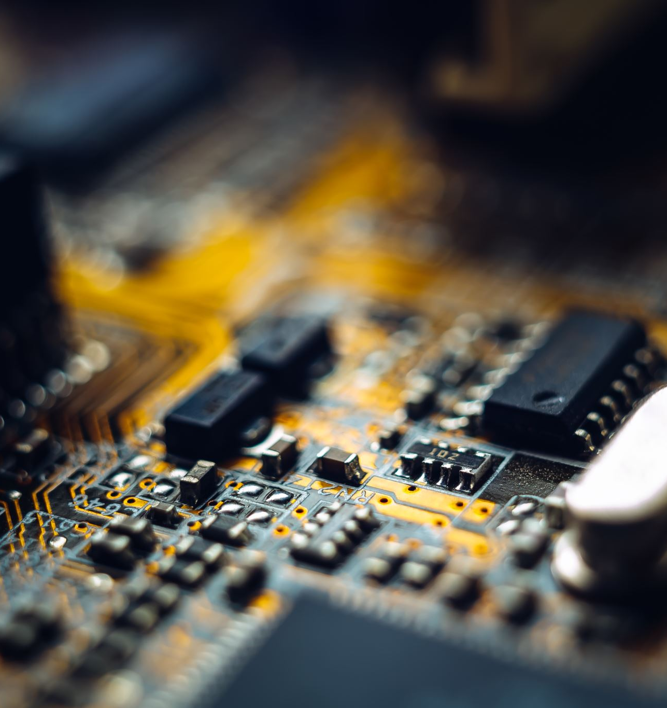
Microcontroller

Slide 3
What is Microcontroller ?
Self-contained computer systems that contains a microprocessor, memory and input/output peripherals on a single chip.
They typically include a input/output (I/O) interfaces, and other peripherals like timers, counters, and analog-to-digital converters.

Slide 4
Features of Microcontroller
Input/output: include a range of digital and analog I/O ports
Microcontrollers have built-in timers and counters that enable them to measure time and count external events.
Interrupt system: Microcontrollers may include an interrupt system that allows the device to respond quickly to external events or signals,

Slide 5
Types of Microcontrollers
PIC - 1975
AVR - 1996
Developed by General Instruments.
PIC families: PIC16, PIC17, PIC18
Doesn’t have common tutorials online compare to AVR.
Developed by ATMEL.
PIC families: Atiny, Atmega, XMEGA
Have a more beginner-friendly development environment

Slide 6

Microcontrollers are most seen in embedded systems

Slide 7

What is meaning of Embded systems ?

Slide 8
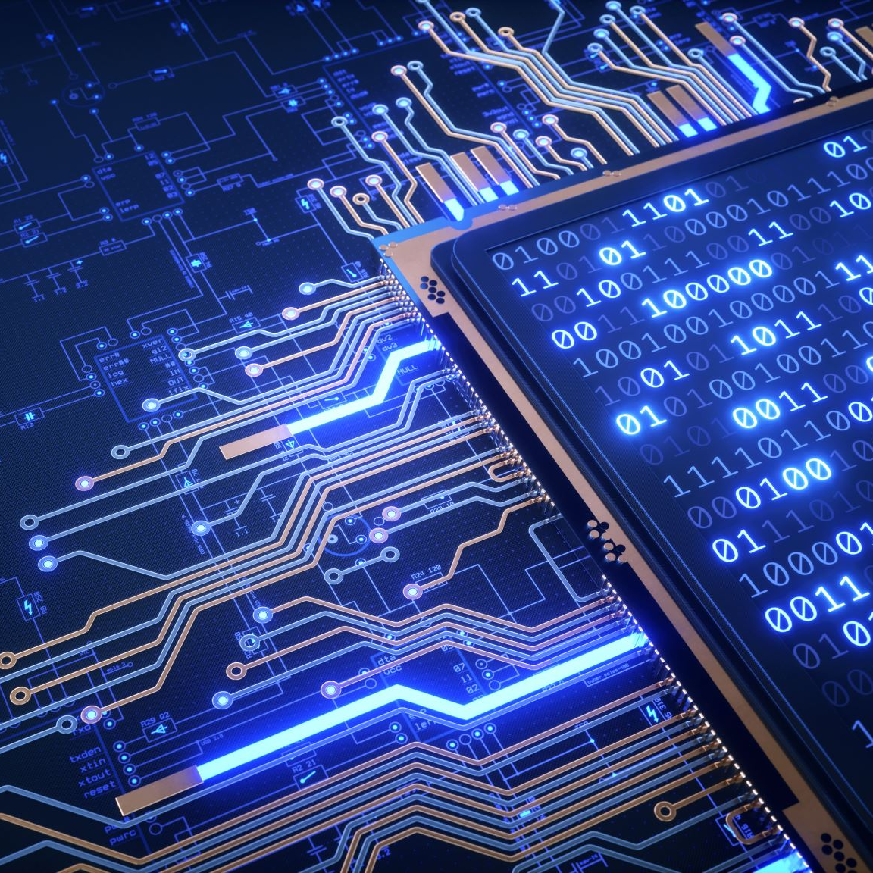
Embedded systems
System designed as software and hardware to do specific task repeatedly. Task can be simple or complex.
Computer and smartphones are not embedded systems they are General purpose Devices capable of doing variety of tasks

Slide 9
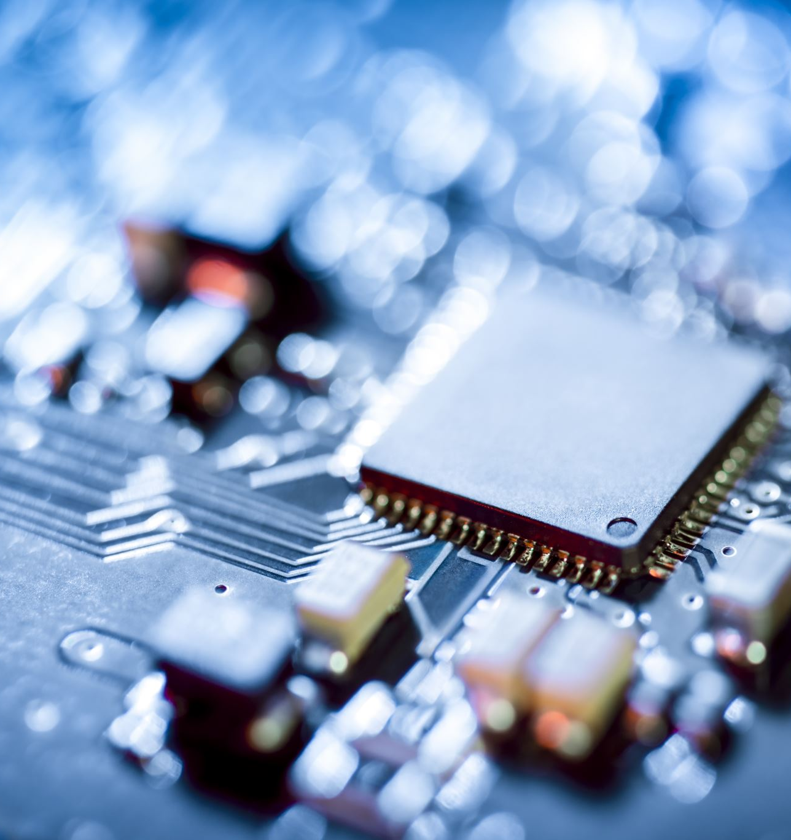
Microprocessor

Slide 10
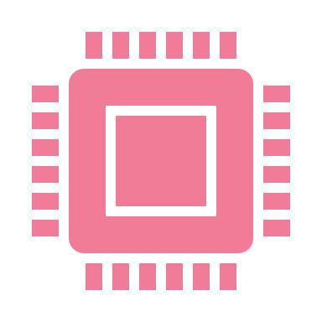
what is Microprocessor ?
A microprocessor is a central processing unit (CPU) that is designed to perform the basic arithmetic, logical, and control operations of a computer. It is a small and highly integrated electronic device that is used to control and process data in various applications, ranging from simple consumer electronics to complex industrial machinery.

Slide 11
Types of Microprocessors
General Purpose Microprocessors:
designed to perform a wide range of general-purpose computing tasks. Examples include the Intel x86 family and the ARM architecture.
Embded Microprocessors:
These microprocessors are designed to be integrated into embedded systems
System-on-chip (SoC) microprocessor:
These microprocessors are designed to integrate all the necessary components for a complete system onto a single chip. Examples include the Qualcomm Snapdragon and the Apple A-series chips.

Slide 12
Summary
Microprocessor
Microcontroller
Is the heart of computer systems
Only a processor, so memory and I/O components need to be connected externally
Cost of the entire system is high
Microprocessors are based on Von Neumann model.
Is the heart of embedded system
Has a processor along with internal memory and I/O components.
Cost of the entire system is low
Microcontrollers are based on Harvard architecture.

